Slide 1
Gender Pay Gap: UK Rail
Report 2023*
* A full narrative report will follow shortly

Slide 2
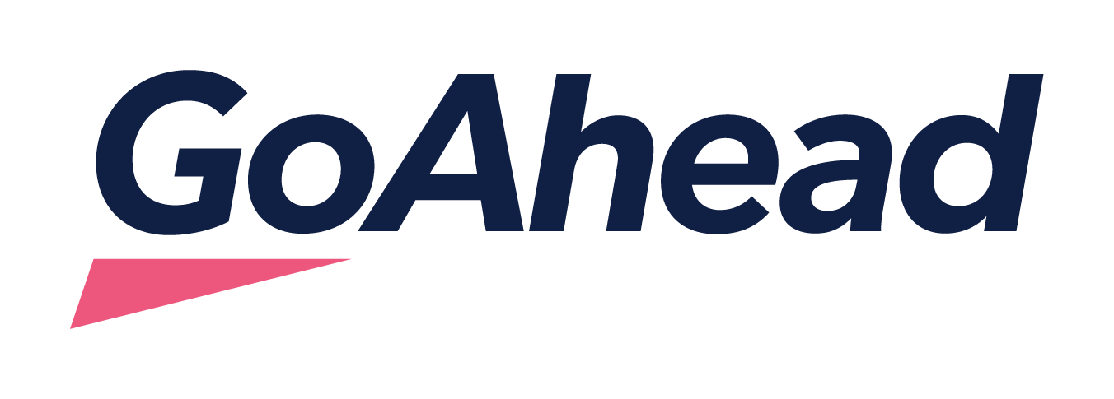
UK Rail Results
In this report, we present the results for Govia Thameslink Rail.
Looking at the total UK Rail workforce, our gender pay gap analysis shows that the median pay is 31.1% in favour of men, which is higher than the UK National average of 14.3%* *Office for National Statistics 2023
Since 2022, the UK Rail median pay gap increased by 7.6 percentage points.
The UK Rail mean pay gap is 17.4% in favour of men, an improvement of 2 percentages points since last year and reflects the greater number of women drivers that have been recruited.
The median bonus is 37.8% in favour of men, increased by 31.1 percentage points from previous year.

Slide 3
A closer look at our UK Rail results
2023 Pay Gap |  | 2023 Bonus Gap |  | Receiving a Bonus
Median | Mean | Median | Mean | Men | Women
31.1% | 17.4% | 37.8% | 19.6% | 15.8% | 23.2%
Population by pay quartiles:
Upper Quartile |  | Upper Middle |  | Lower Middle |  | Lower Quartile
Men | Women | Men | Women | Men | Women | Men | Women
91% | 9% | 84.9% | 15.1% | 74.8% | 25.2% | 71.6% | 28.4%

